Slide 1

Part 1 Storyboard BRK - information jungle

Slide 2


Slide 3
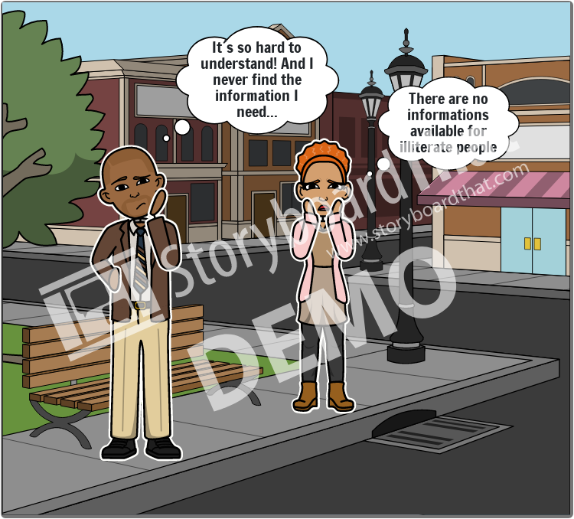

Slide 4
